Slide 1



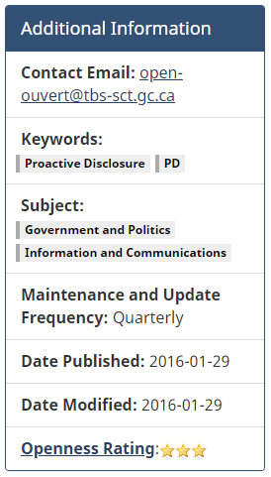
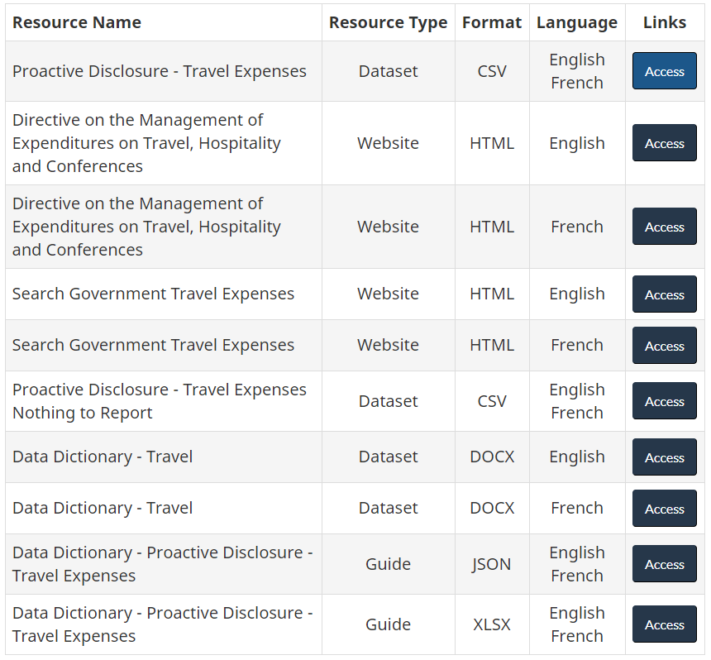
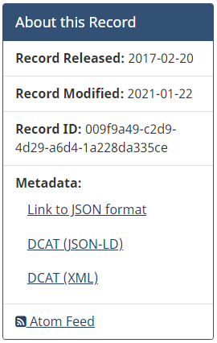

Proactive disclosure: travel expenses
Our group used open.canada.ca
This dataset consolidates all the Travel Expense reports submitted by federal institutions.
It is important to note that the government is interested in reducing expenses, reason enough to collect this data year to year.
Travel Expenses: The rules and principles are outlined in the Policies for Ministers' Offices, in Treasury Board's Travel Directive and Special Travel Authorities.

Slide 2
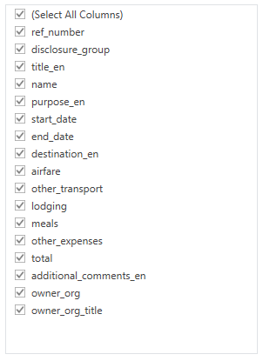
initial exploration
The dataset presents a number of categories to explore.
The uncleaned data is extensive, showing 1 000 000+ entries over the span of 18 years.
A number of categories can be removed: ref_number, disclosure_group, the French categories, additional_comments, owner_org.
Our group chose to focus on the last three years: 2018, 2019 and 2020.
After the initial clean, the data is reduced significantly with just over 300 000 entries.

Slide 3
Metadata/data dictionary - travel
Dataset Fields
Data Dictionary
Field Names | Brief Descriptions | Format
ref_number | Reference Number | Text
disclosure_group | Disclosure Group | Text
title_en | Title (English) | Text
title_fr | Title (French) | Text
name | Name | Text
purpose_en | Purpose of Travel (English) | Text
purpose_fr | Purpose of Travel (French) | Text
start_date | Travel Start Date | Date
end_date | Travel End Date | Date
destination_en | Destination (English) | Text
destination_fr | Destination (French) | Text
airfare | Airfare | Numeric
other_transport | Other Transportation | Numeric
lodging | Accommodation | Numeric
meals | Meals and incidentals | Numeric
other_expenses | Other Expenses | Numeric
total | Total Amount | Numeric
additional_comments_en | Additional Comments (English) | Text
additional_comments_fr | Additional Comments (French) | Text
owner_org | Owner Organisation Code | Text
owner_org_title | Owner Organisation Title (English and French) | Text
Attribute | Attribute Description
Field Name | This text should correspond directly with the field name in your template
Description | This provides a brief description of the element
Obligation | Indicates whether the element is required to always or sometimes be present (i.e., contain a value). Options are: Mandatory Mandatory, conditional Optional
Condition | Describes the condition or conditions according to which a value shall be present
Format Type | Indicates the required format of the values, if any, at the file level. “Free text” indicates that the value may be input using natural language (i.e., there is no constraint) while “Text” indicates the value comes from a controlled vocabulary specified in the Encoding Scheme attribute
Validation | Indicates what the system will accept in this field
Validation Errors | This section indicates when an error has been made. It will detail the error and provide instruction on how to correct it.
Data Dictionary: Entry Sample
Attribute | Attribute Description
Field Name | Purpose of Travel (English)
Description | A description of the reason for the government trip in question. The description should be succinct (one line if possible) and provide users with a general sense of the trip's purpose. Use of acronyms should be avoided, in English.
Obligation | Mandatory
Condition | N/A
Format Type | Free text
Validation | This field must not be empty

Slide 4
Potential Questions to explore
Which factions of the Government have spent the most in 2018, 2019 and 2020? (Overall totals)
Where are the majority of travel expenses going?
Where are the most popular destinations?
Is there a consistency in the role of the travelling individual?
What effect did COVID-19 have on expenses?

Slide 5
Selected questions
Which factions of the Government have spent the most in 2018, 2019 and 2020? (Combined yearly totals)
Where are the majority of travel expenses going?
Where are the most popular destinations?
Is there a consistency in the role of the travelling individual?
What effect did COVID-19 have on expenses?

Slide 6
Data quality issues
Field | Issue | Magnitude | Decision Taken
End Date | Wrong Values: Wrong Format Impossibly high years (e.g. year 21xx, 3xxx) | 9 records | Corrected to mimic “Start Date”
End Date | Some “End Dates” are blank | 804 records | Corrected to mimic “Start Date”
Total (expenses) | “Total” expenses exceeding 300K CAD for short trips, likely a decimal oversight | 4 records | Corrected using the sum of all expense fields (e.g. airfare + other + lodging)
Total (expenses) | “Total” expenses are not equal to the sum of all individual expenses (e.g. airfare + other + lodging) | 2266 records | Noted these records, decided to use anyway for overall totals
Airfare, other_transport, lodging, meals | Extreme values exceeding 800K | 4 records | Decided to ignore values as only the “Total” field was required for analysis
Issue | Decision Taken
The year 2020 is limited with data from January to November (December is excluded) | Ignore – the Analysis was performed on an overall annual basis. Assumed that December 2020 would not significantly change the analysis due to COVID-19 and the travel restrictions in place.
Prior to 2018, many divisions do not have travel data | Ignore – the group decided to focus on the last 3 of available data to address the assignment business question

Slide 7
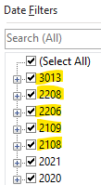
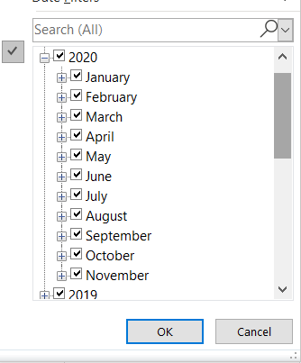
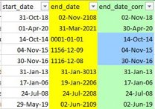
Data quality issues - Visuals
start_date | end_date
43,418.00 | 43,431.00
43,833.00 | 43,840.00
43,613.00 | 43,641.00
41,688.00 | 41,699.00
39,549.00 | 39,565.00
43,141.00 | 43,155.00

Slide 8
Question 1: which factions of the government spent the most? #1 – national defence

Slide 9
Question 1: which factions of the government spent the most? #2 – department of finance

Slide 10
Question 1: which factions of the government spent the most? #3 – innovation, science and economic development

Slide 11
Question 2: Where are the majority of Travel expenses going?

Slide 12
Question 3: what effect did covid-19 have on expenses?
Year | airfare | meals | other_transport | other_expenses | lodging
2018 | 3473708.82 | 474849.35 | 159920.89 | 53843.96 | 866956.87
2019 | 1954364.1 | 254313.98 | 86756.76 | 30620.59 | 419079.41
2020 | 206994.52 | 50035.43 | 17329.68 | 2716.51 | 70710.1
2019 % of 2018 | 56% | 54% | 54% | 57% | 48%
2020 % of 2019 | 11% | 20% | 20% | 9% | 17%

Slide 14
Final thoughts
Top three spenders with totals:
1. National Defence - $4 898 761.56
2. Department of Finance - $2 250 185.86
3. Innovation, Science and Economic Development - $2 148 289.17
Airfare was the main expense for all of the top three companies.
The average percentage spent on airfare was between 60 – 70% of total travel expenses.
COVID-19 had a huge impact on government spending relating to travel.
In 2019, just under $2 000 000 was spent on travel;
In 2020, not even $150 000 was spent on travel.
Even without the effects of COVID-19, the graph shows a decrease in travel expenses from 2018 to 2019 of significant value.
2018: Approximately $3 500 000;
2019: Approximately $2 000 000.

